Slide 1
Pattern Mining: Basic Concepts and Methods
Basic Concepts
Frequent Itemset Mining Methods
Which Patterns Are Interesting?—Pattern Evaluation Methods
Summary

Slide 2
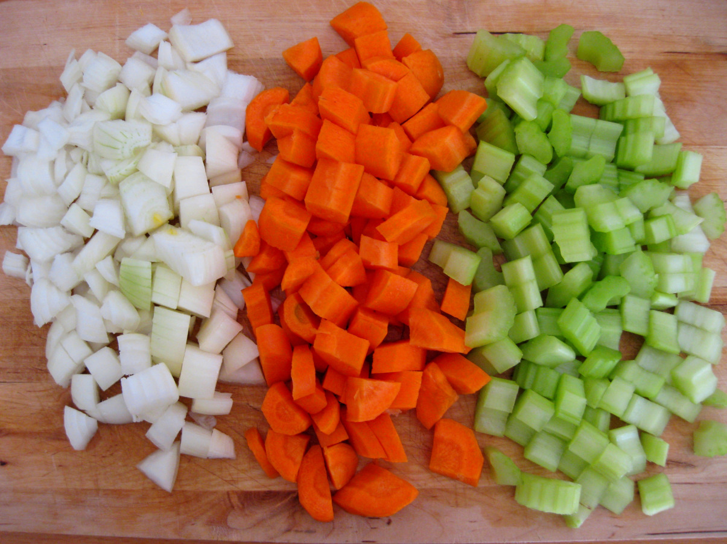
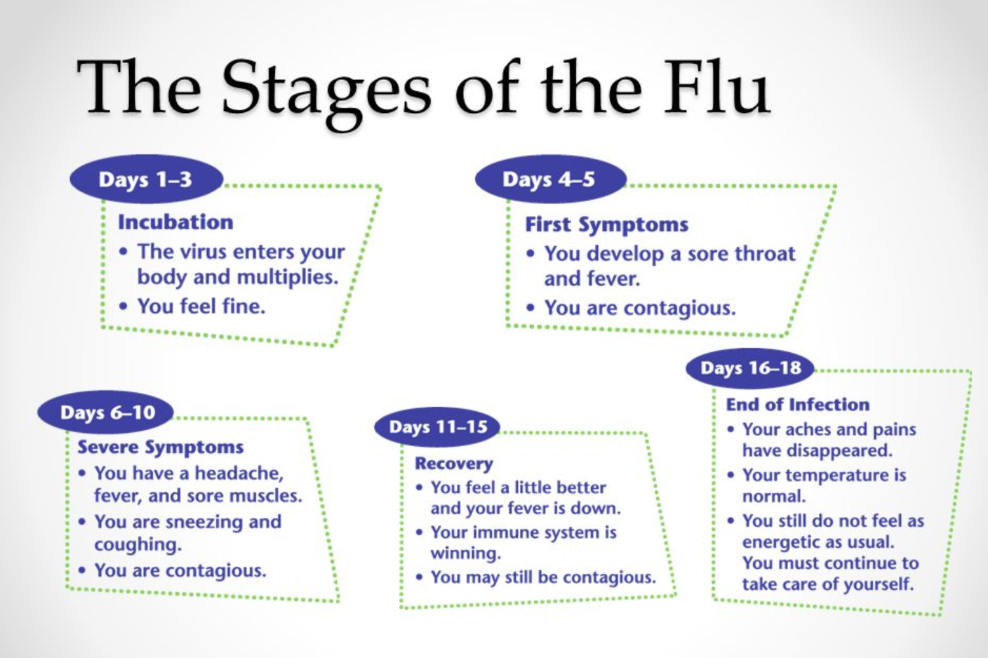
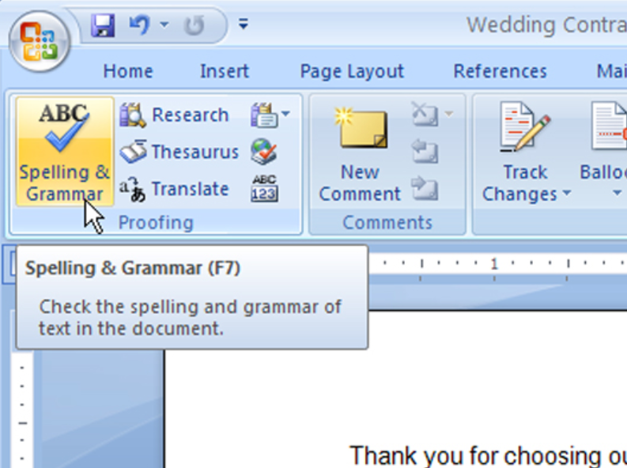
What Are Patterns?
What are patterns?
Patterns: A set of items, subsequences, or substructures that occur frequently together (or strongly correlated) in a data set
Patterns represent intrinsic and important properties of datasets
Frequent item set
Frequent sequences
Frequent structures

Slide 3
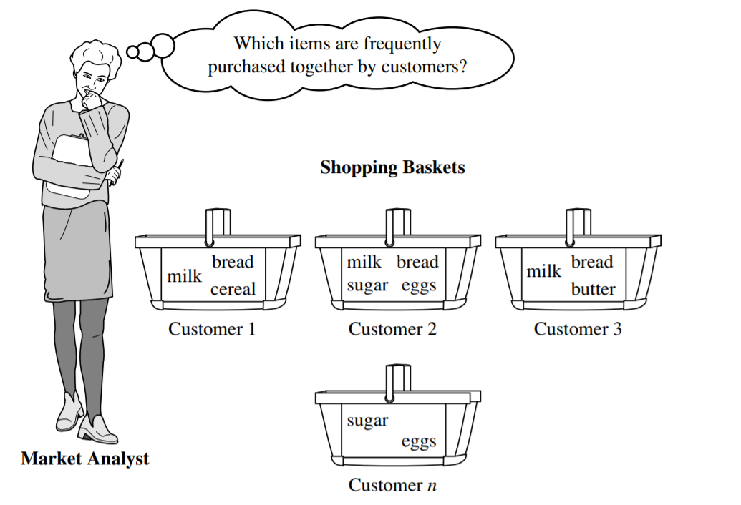
What Is Pattern Discovery?
Pattern discovery: Uncovering patterns from massive data sets
It can answer questions such as:
What products were often purchased together?
What are the subsequent purchases after buying an iPad?

Slide 4
Pattern Discovery: Why Is It Important?
Foundation for many essential data mining tasks
Association, correlation, and causality analysis
Mining sequential, structural (e.g., sub-graph) patterns
Classification: Discriminative pattern-based analysis
Cluster analysis: Pattern-based subspace clustering
Broad applications
Market basket analysis, cross-marketing, catalog design, sale campaign analysis, Web log analysis, biological sequence analysis
Many types of data: spatiotemporal, multimedia, time-series, and stream data

Slide 5
Basic Concepts: Transactional Database
Transactional Database (TDB)
Each transaction is associated with an identifier, called a TID.
May also have counts associated with each item sold
Tid | Items bought
1 | Bread, Nuts, Cheese
2 | Bread, Coffee, Cheese
3 | Bread, Cheese, Eggs
4 | Nuts, Eggs, Milk
5 | Nuts, Coffee, Cheese, Eggs, Milk

Slide 6
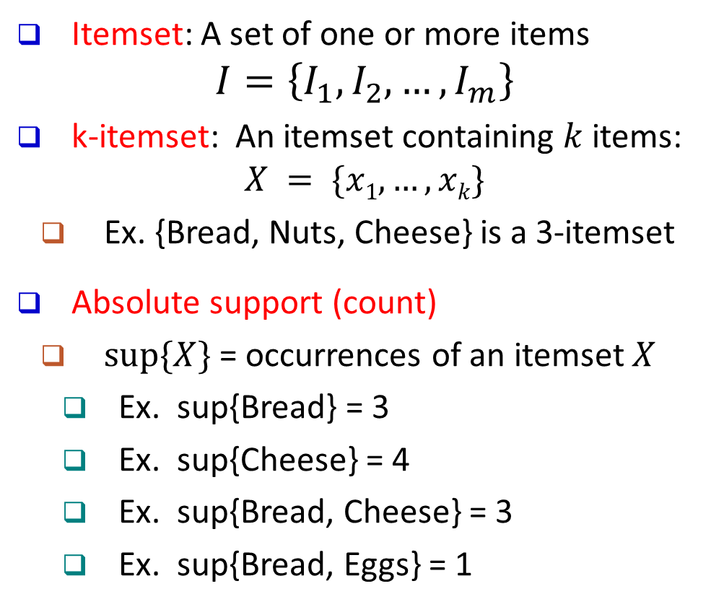
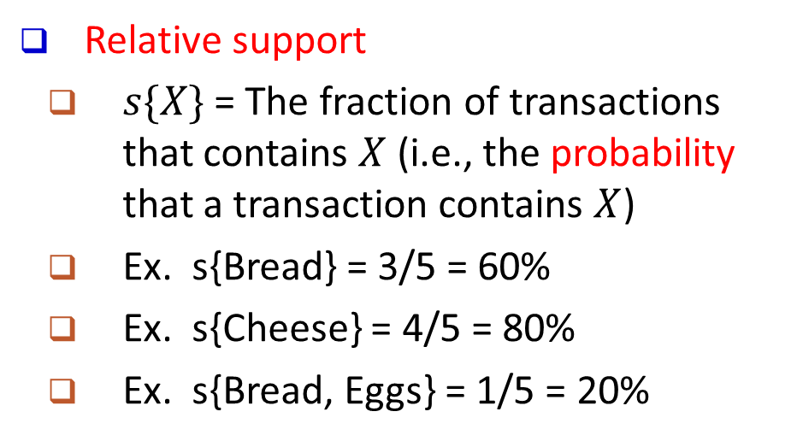
Basic Concepts: k-Itemsets and Their Supports
Itemset: A set of one or more items
$$I=\left\{I_{1},I_{2},…,I_{m}\right\}$$
k-itemset: An itemset containing $k$ items:
$$X = \{x1, …, xk\}$$
Ex. {Bread, Nuts, Cheese} is a 3-itemset
Absolute support (count)
$sup⁡\{X\}$ = occurrences of an itemset $X$
Ex. sup{Bread} = 3
Ex. sup{Cheese} = 4
Ex. sup{Bread, Cheese} = 3
Ex. sup{Bread, Eggs} = 1
Tid | Items bought
1 | Bread, Nuts, Cheese
2 | Bread, Coffee, Cheese
3 | Bread, Cheese, Eggs
4 | Nuts, Eggs, Milk
5 | Nuts, Coffee, Cheese, Eggs, Milk
Relative support
$s\{X\}$= The fraction of transactions that contains $X$ (i.e., the probability that a transaction contains $X$)
Ex. s{Bread} = 3/5 = 60%
Ex. s{Cheese} = 4/5 = 80%
Ex. s{Bread, Eggs} = 1/5 = 20%

Slide 7
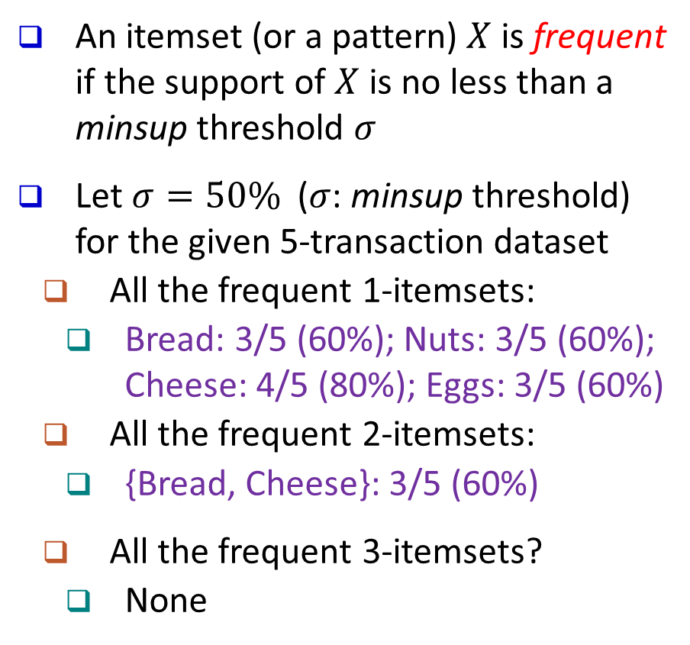
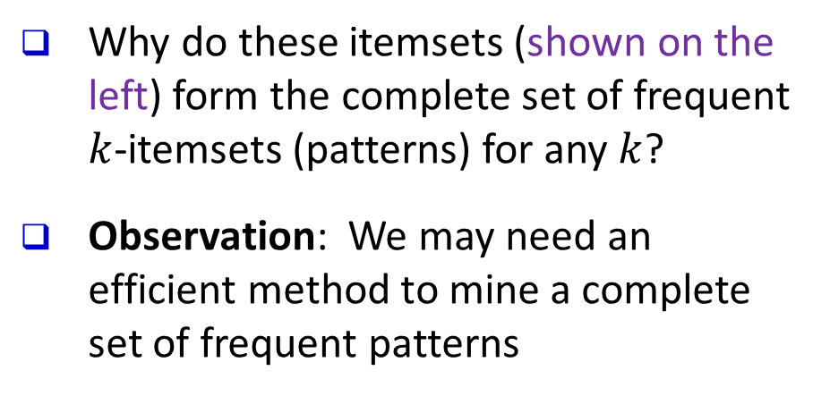
Basic Concepts: Frequent Itemsets (Patterns)
An itemset (or a pattern) $X$ is frequent if the support of $X$ is no less than a minsup threshold $σ$
Let $σ=50\%$ ($σ$: minsup threshold) for the given 5-transaction dataset
All the frequent 1-itemsets:
Bread: 3/5 (60%); Nuts: 3/5 (60%); Cheese: 4/5 (80%); Eggs: 3/5 (60%)
All the frequent 2-itemsets:
{Bread, Cheese}: 3/5 (60%)
All the frequent 3-itemsets?
None
Tid | Items bought
1 | Bread, Nuts, Cheese
2 | Bread, Coffee, Cheese
3 | Bread, Cheese, Eggs
4 | Nuts, Eggs, Milk
5 | Nuts, Coffee, Cheese, Eggs, Milk
Why do these itemsets (shown on the left) form the complete set of frequent $k$-itemsets (patterns) for any $k$?
Observation: We may need an efficient method to mine a complete set of frequent patterns

Slide 8
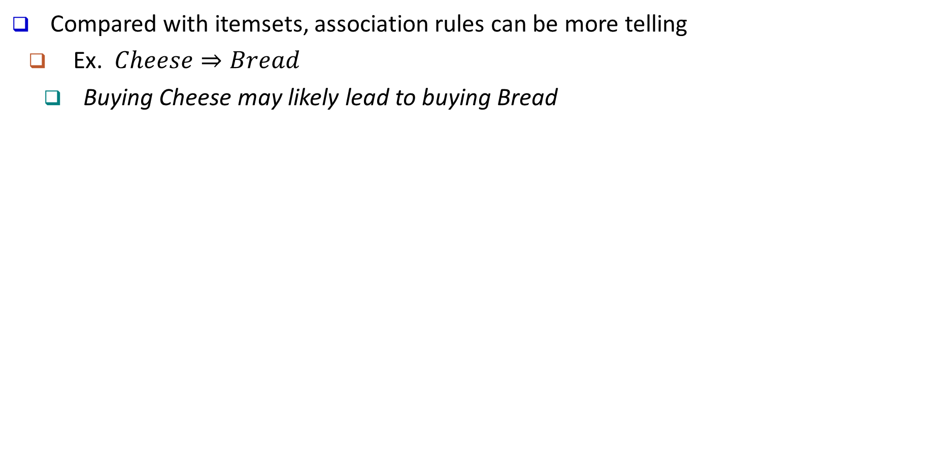
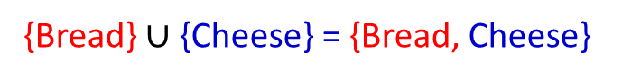
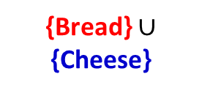
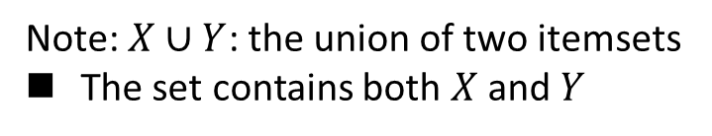
From Frequent Itemsets to Association Rules
Compared with itemsets, association rules can be more telling
Ex. $Cheese⇒Bread$
Buying Cheese may likely lead to buying Bread
Containing both
Containing Cheese
{Bread} $∪$ {Cheese}
Bread
Cheese
Containing Bread
{Bread} $∪$ {Cheese} = {Bread, Cheese}
Note: $X∪Y$: the union of two itemsets
The set contains both $X$ and $Y$

Slide 9
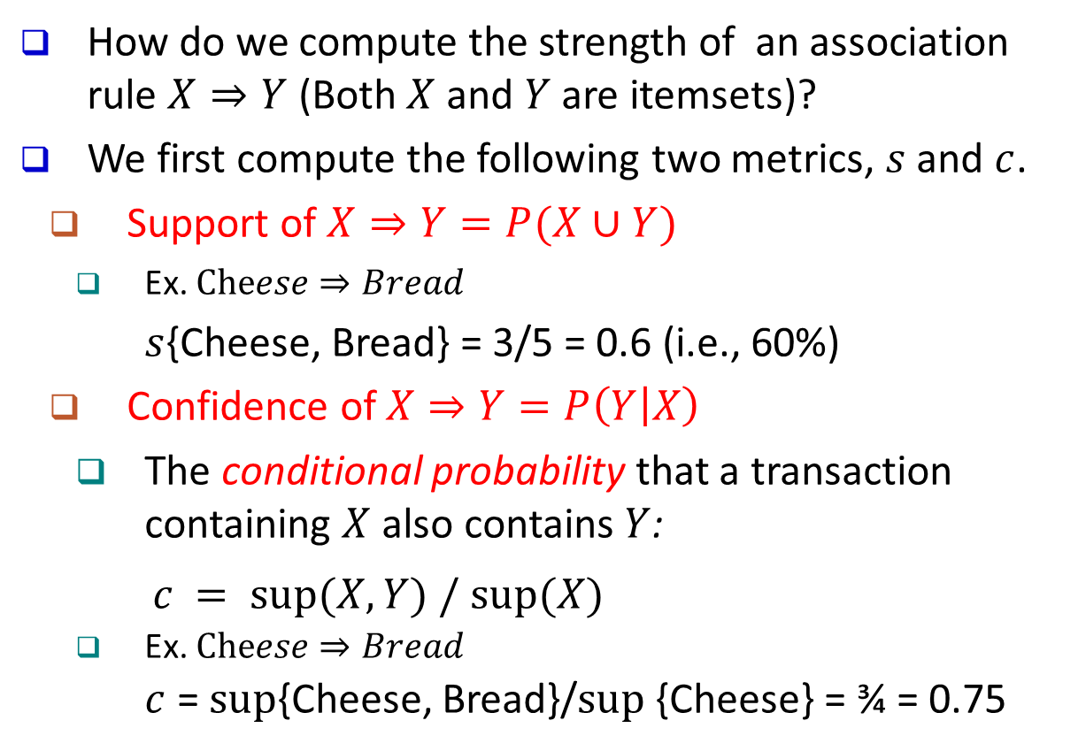
Association Rules
How do we compute the strength of an association rule $X⇒Y$ (Both $X$ and $Y$ are itemsets)?
We first compute the following two metrics, $s$ and $c$.
Support of $X⇒Y=P(X∪Y)$
Ex. $Cheese⇒Bread$
$s${Cheese, Bread} = 3/5 = 0.6 (i.e., 60%)
Confidence of $X⇒Y=P\left(Y | X\right)$
The conditional probability that a transaction containing $X$ also contains $Y$:
$c = sup⁡(X, Y) / sup⁡(X)$
Ex. $Cheese⇒Bread$
$c$ = $sup${Cheese, Bread}/$sup⁡${Cheese} = ¾ = 0.75
Tid | Items bought
1 | Bread, Nuts, Cheese
2 | Bread, Coffee, Cheese
3 | Bread, Cheese, Eggs
4 | Nuts, Eggs, Milk
5 | Nuts, Coffee, Cheese, Eggs, Milk
In pattern analysis, we are often interested in those rules that dominate the database, and these two metrics ensure the popularity and correlation of $X$ and $Y$.

Slide 10
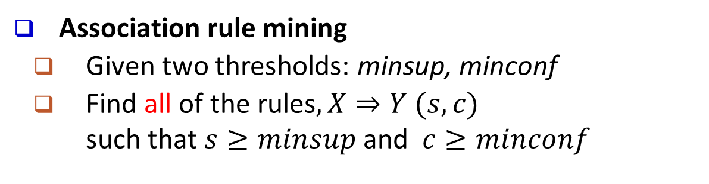
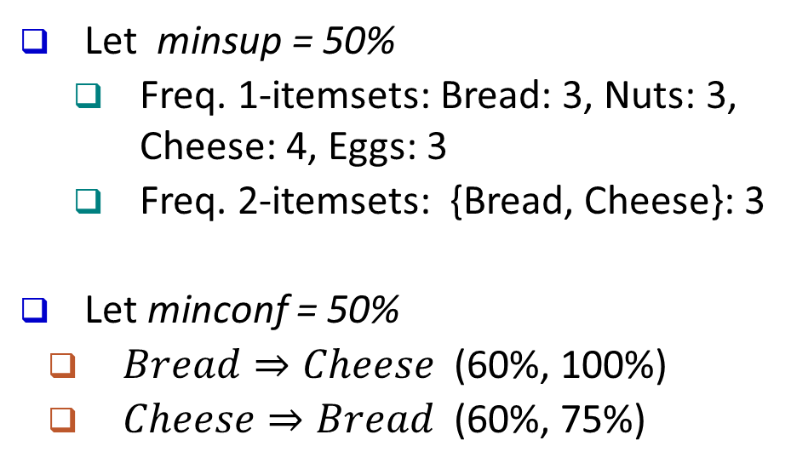
Mining Frequent Itemsets and Association Rules
Association rule mining
Given two thresholds: minsup, minconf
Find all of the rules$, X⇒Y (s, c)$ such that $s≥minsup$ and $c≥minconf$
Tid | Items bought
1 | Bread, Nuts, Cheese
2 | Bread, Coffee, Cheese
3 | Bread, Cheese, Eggs
4 | Nuts, Eggs, Milk
5 | Nuts, Coffee, Cheese, Eggs, Milk
Let minsup = 50%
Freq. 1-itemsets: Bread: 3, Nuts: 3, Cheese: 4, Eggs: 3
Freq. 2-itemsets: {Bread, Cheese}: 3
Let minconf = 50%
$Bread⇒Cheese$ (60%, 100%)
$Cheese⇒Bread$ (60%, 75%)
Observations:
Mining association rules and mining frequent patterns are very close problems
Scalable methods are needed for mining large datasets
(Q: Are these all the rules satisfying the two conditions?)

Slide 11
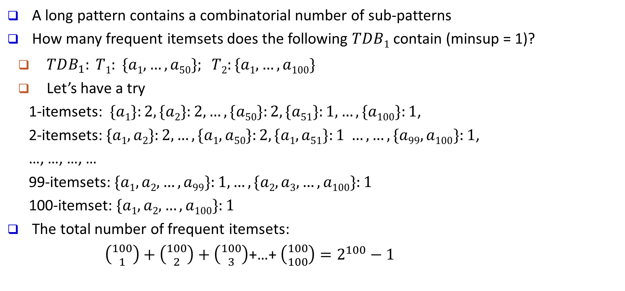
Challenge: There Are Too Many Frequent Patterns!
A long pattern contains a combinatorial number of sub-patterns
How many frequent itemsets does the following $TDB1$ contain (minsup = 1)?
$TDB_{1}: T1: \{a1, …, a50\}; T2:\{a1, …, a100\}$
Let’s have a try
1-itemsets: $\{a1\}:2, \{a2\}:2, …, \{a50\}:2, \{a51\}:1, …, \{a100\}:1$,
2-itemsets: $\{a1, a2\}:2, …, \{a1, a50\}:2, \{a1, a51\}:1 …, …, \{a99, a100\}:1$,
…, …, …, …
99-itemsets: $\{a1, a2, …, a99\}:1, …, \{a2, a3, …, a100\}:1$
100-itemset: $\{a1, a2, …, a100\}:1$
The total number of frequent itemsets:
$\left({100 \atop 1}\right)+\left({100 \atop 2}\right)+\left({100 \atop 3}\right)$+…+ $\left({100 \atop 100}\right)=2^{100}−1$
A too huge set for any one to compute or store!

Slide 12
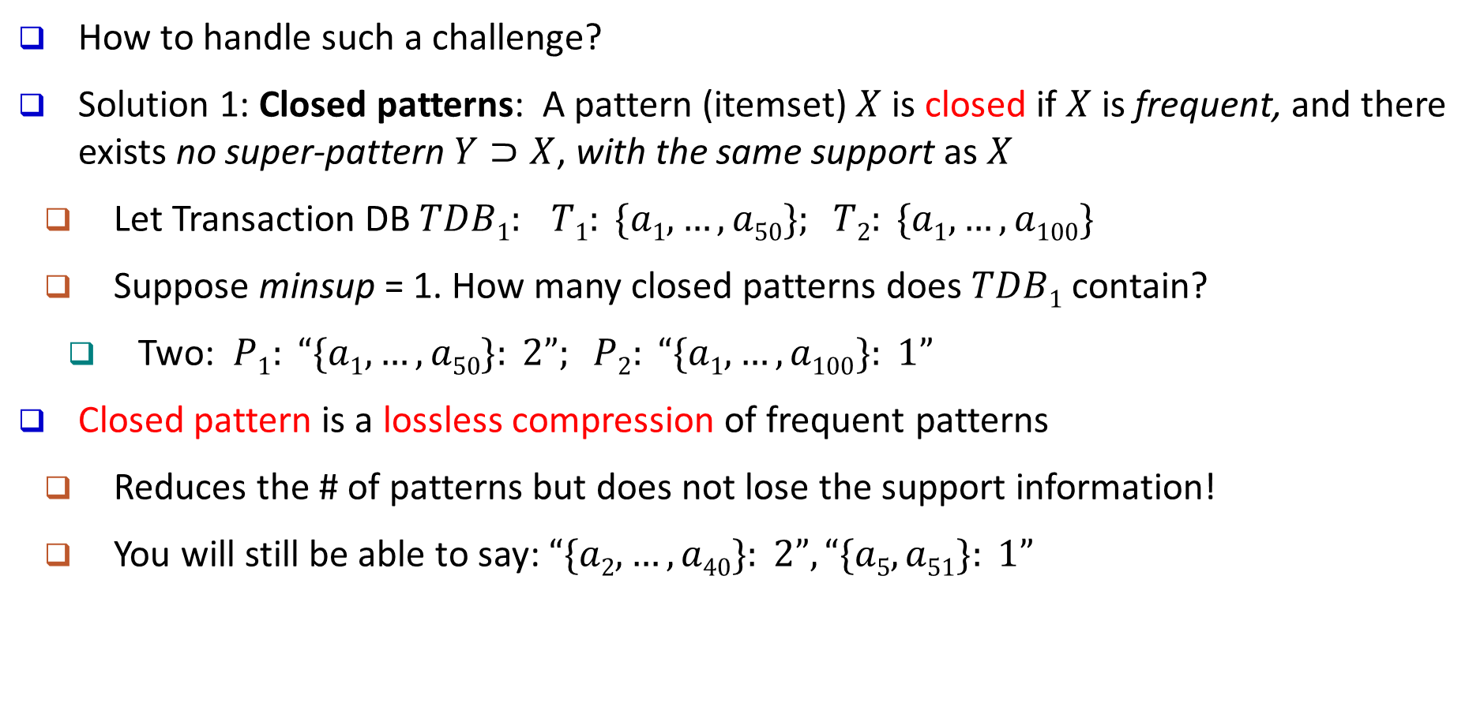
Expressing Patterns in Compressed Form: Closed Patterns
How to handle such a challenge?
Solution 1: Closed patterns: A pattern (itemset) $X$ is closed if $X$ is frequent, and there exists no super-pattern $Y⊃X$, with the same support as $X$
Let Transaction DB $TDB1: T1: \{a1, …, a50\}; T2: \{a1, …, a100\}$
Suppose minsup = 1. How many closed patterns does $TDB1$contain?
Two: $P1: “\{a1, …, a50\}: 2”; P2: “\{a1, …, a100\}: 1”$
Closed pattern is a lossless compression of frequent patterns
Reduces the # of patterns but does not lose the support information!
You will still be able to say: $“\{a2, …, a40\}: 2”, “\{a5, a51\}: 1”$

Slide 13
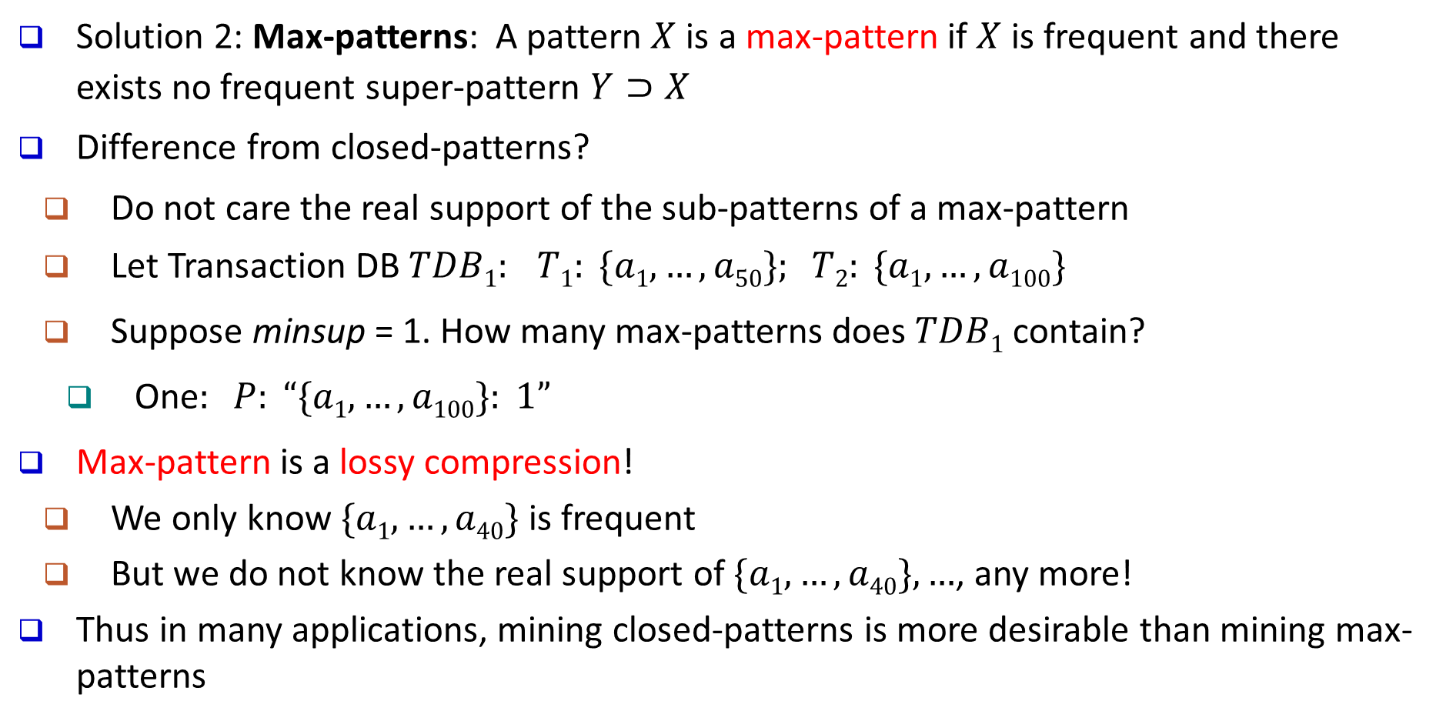
Expressing Patterns in Compressed Form: Max-Patterns
Solution 2: Max-patterns: A pattern $X$ is a max-pattern if $X$ is frequent and there exists no frequent super-pattern $Y⊃X$
Difference from closed-patterns?
Do not care the real support of the sub-patterns of a max-pattern
Let Transaction DB $TDB1: T1: \{a1, …, a50\}; T2: \{a1, …, a100\}$
Suppose minsup = 1. How many max-patterns does $TDB1$contain?
One$: P: “\{a1, …, a100\}: 1”$
Max-pattern is a lossy compression!
We only know $\{a1, …, a40\}$ is frequent
But we do not know the real support of $\{a1, …, a40\}, …$, any more!
Thus in many applications, mining closed-patterns is more desirable than mining max-patterns

Slide 14
Pattern Mining: Basic Concepts and Methods
Basic Concepts
Frequent Itemset Mining Methods
Which Patterns Are Interesting?—Pattern Evaluation Methods
Summary

Slide 15
Efficient Pattern Mining Methods
The Downward Closure Property of Frequent Patterns
The Apriori Algorithm
Extensions or Improvements of Apriori
Mining Frequent Patterns by Exploring Vertical Data Format
FPGrowth: A Frequent Pattern-Growth Approach
Mining Closed Patterns

Slide 16
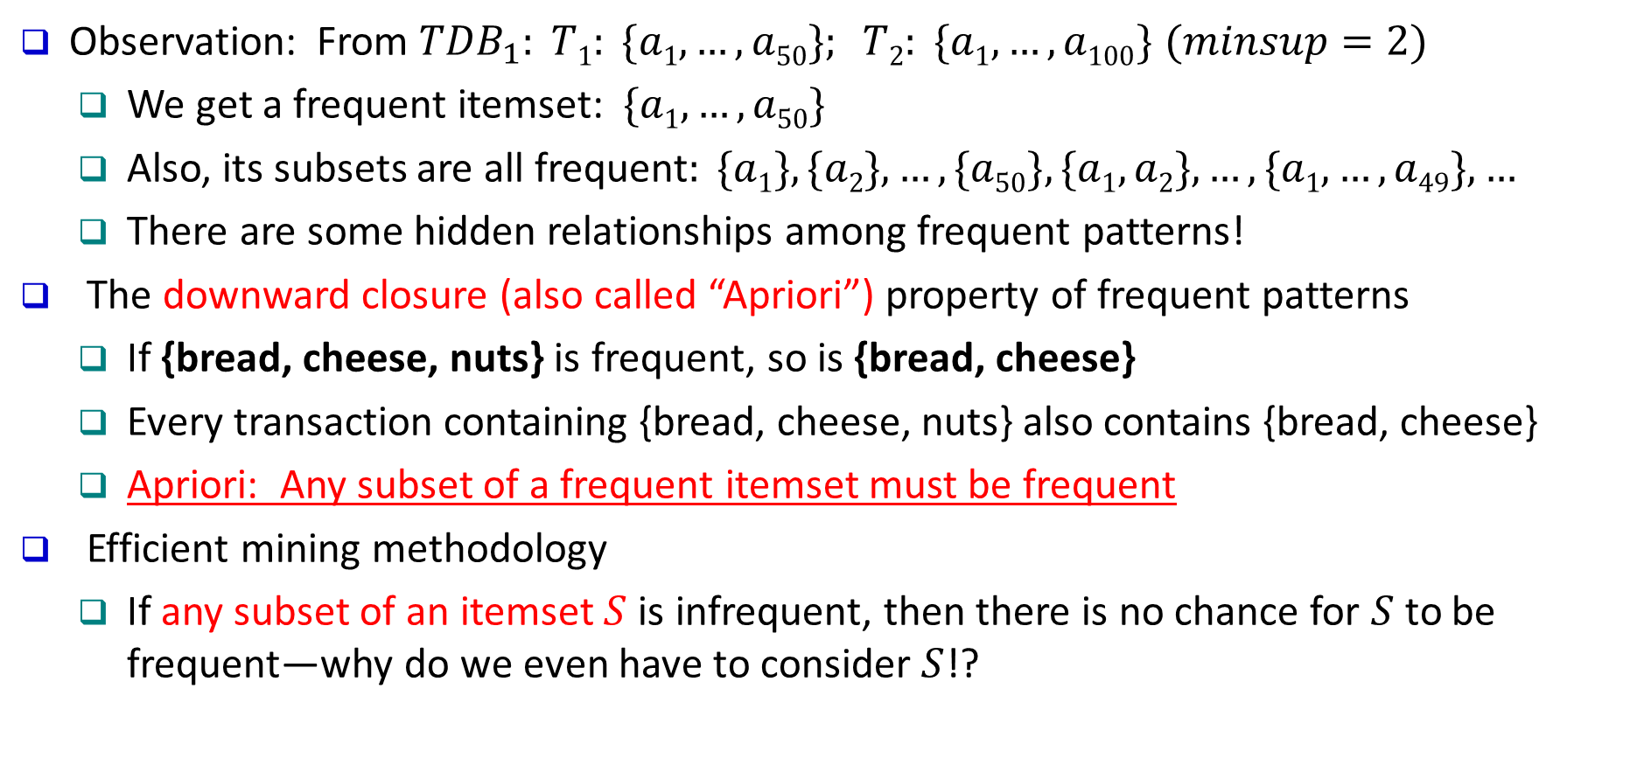
The Downward Closure Property of Frequent Patterns
Observation: From $TDB_{1}: T1: \{a1, …, a50\}; T2: \{a1, …, a100\}$ $(minsup=2)$
We get a frequent itemset: $\{a1, …, a50\}$
Also, its subsets are all frequent$: \{a1\}, \{a2\}, …, \{a50\}, \{a1, a2\}, …, \{a1, …, a49\}, …$
There are some hidden relationships among frequent patterns!
The downward closure (also called “Apriori”) property of frequent patterns
If {bread, cheese, nuts} is frequent, so is {bread, cheese}
Every transaction containing {bread, cheese, nuts} also contains {bread, cheese}
Apriori: Any subset of a frequent itemset must be frequent
Efficient mining methodology
If any subset of an itemset $S$ is infrequent, then there is no chance for $S$ to be frequent—why do we even have to consider $S$!?
A sharp knife for pruning!

Slide 17
Apriori Pruning and Scalable Mining Methods
Apriori pruning principle: If there is any itemset which is infrequent, its superset should not even be generated! (Agrawal & Srikant @VLDB’94, Mannila, et al. @ KDD’ 94)
Scalable mining Methods: Three major approaches
Level-wise, join-based approach: Apriori (Agrawal & Srikant@VLDB’94)
Vertical data format approach: Eclat (Zaki, Parthasarathy, Ogihara, Li @KDD’97)
Frequent pattern projection and growth: FPgrowth (Han, Pei, Yin @SIGMOD’00)

Slide 18
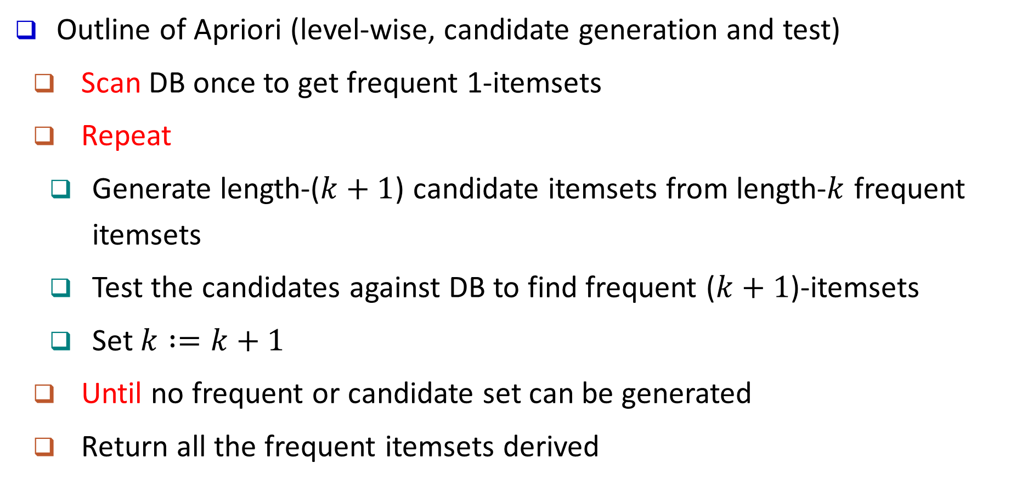
Apriori: A Candidate Generation & Test Approach
Outline of Apriori (level-wise, candidate generation and test)
Scan DB once to get frequent 1-itemsets
Repeat
Generate length-($k+1$) candidate itemsets from length-$k$ frequent itemsets
Test the candidates against DB to find frequent ($k+1$)-itemsets
Set $k :=k+1$
Until no frequent or candidate set can be generated
Return all the frequent itemsets derived

Slide 19
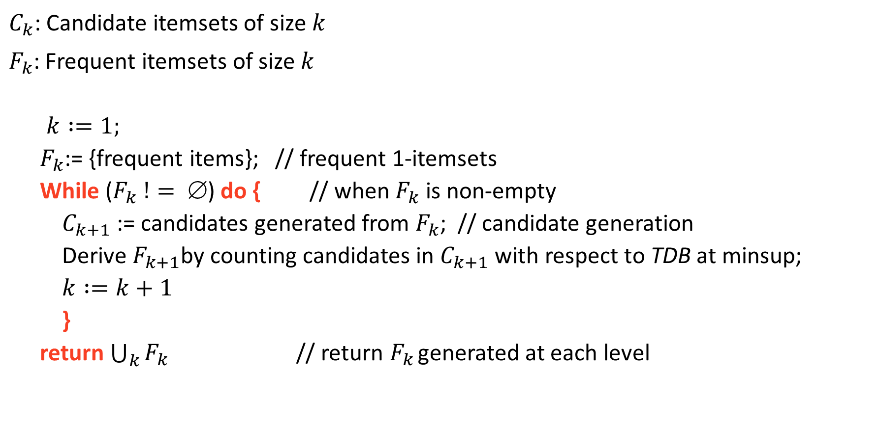
The Apriori Algorithm (Pseudo-Code)
$C_{k}$: Candidate itemsets of size $k$
$F_{k}$: Frequent itemsets of size $k$
$$k :=1;$$
$F_{k}$:= {frequent items}; // frequent 1-itemsets
While ($F_{k} != $) do { // when $F_{k}$ is non-empty
$C_{k+1}$ := candidates generated from $F_{k}$; // candidate generation
Derive $F_{k+1}$by counting candidates in $C_{k+1}$ with respect to TDB at minsup;
$k :=k+1$
}
return $\bigcup_{k}{F_{k}}$ // return $F_{k}$ generated at each level

Slide 20
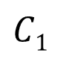
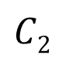
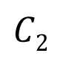
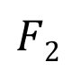
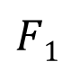
The Apriori Algorithm—An Example
Database TDB
minsup = 2
Itemset | sup
{A} | 2
{B} | 3
{C} | 3
{D} | 1
{E} | 3
$$F1$$
Itemset | sup
{A} | 2
{B} | 3
{C} | 3
{E} | 3
Tid | Items
10 | A, C, D
20 | B, C, E
30 | A, B, C, E
40 | B, E
$$C1$$
1st scan
$$C2$$
$$C2$$
Itemset | sup
{A, B} | 1
{A, C} | 2
{A, E} | 1
{B, C} | 2
{B, E} | 3
{C, E} | 2
Itemset
{A, B}
{A, C}
{A, E}
{B, C}
{B, E}
{C, E}
$$F2$$
Itemset | sup
{A, C} | 2
{B, C} | 2
{B, E} | 3
{C, E} | 2
2nd scan
C₃
Itemset
{B, C, E}
3rd scan
F₃
Itemset | sup
{B, C, E} | 2

Slide 21
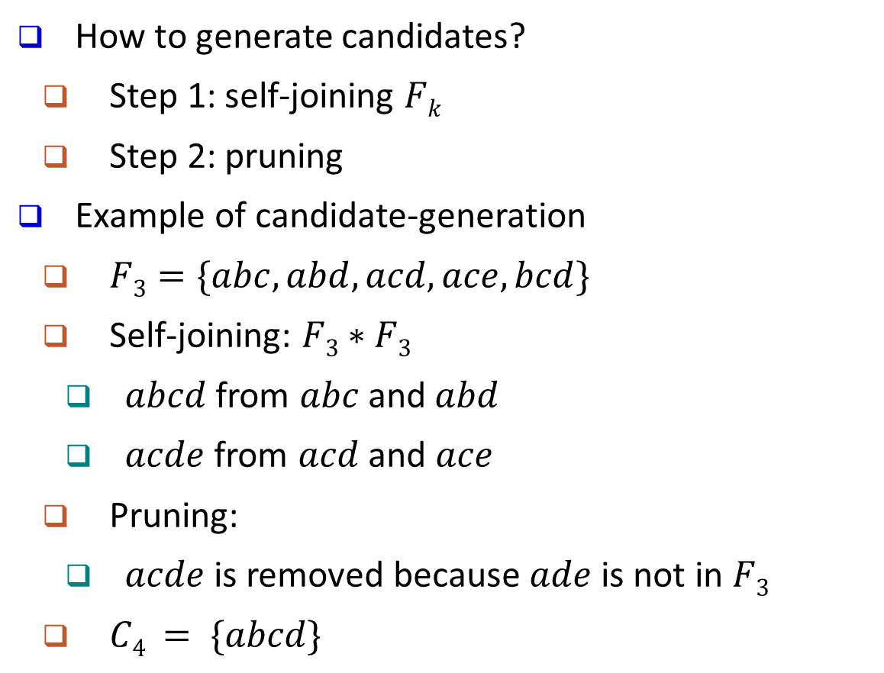
Apriori: Implementation Tricks
How to generate candidates?
Step 1: self-joining $Fk$
Step 2: pruning
Example of candidate-generation
$F3=\{abc, abd, acd, ace, bcd\}$
Self-joining: $F3∗F3$
$abcd$ from $abc$ and$abd$
$acde$ from $acd$ and $ace$
Pruning:
$acde$ is removed because $ade$ is not in $F3$
$C4 = \{abcd\}$
self-join
self-join
abc | abd | acd | ace | bcd
abcd
acde
pruned

Slide 22
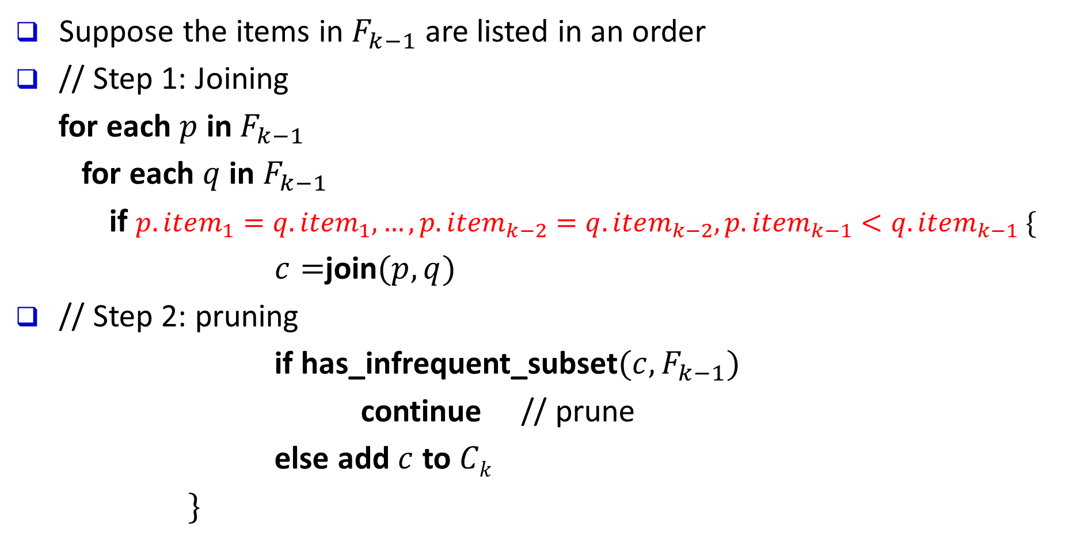
Candidate Generation (Pseudo-Code)
Suppose the items in $F_{k−1}$ are listed in an order
// Step 1: Joining
for each $p$ in $F_{k−1}$
for each $q$ in $F_{k−1}$
if $p.item_{1}=q.item_{1}, …, p.item_{k−2}=q.item_{k−2}, p.item_{k−1}<q.item_{k−1} \{$
$c=$join$(p, q)$
// Step 2: pruning
if has_infrequent_subset$(c, F_{k−1})$
continue // prune
else add $c$ to $Ck$
$\}$
self-join
self-join
zabc | zabd | acd | ace | bcd
zabcd
acde

Slide 23
Apriori: Improvements and Alternatives
Reduce passes of transaction database scans
Partitioning (e.g., Savasere, et al., 1995)
Dynamic itemset counting (Brin, et al., 1997)
Shrink the number of candidates
Hashing (e.g., DHP: Park, et al., 1995)
Pruning by support lower bounding (e.g., Bayardo 1998)
Sampling (e.g., Toivonen, 1996)
Exploring special data structures
Tree projection (Agarwal, et al., 2001)
H-miner (Pei, et al., 2001)
Hypecube decomposition (e.g., LCM: Uno, et al., 2004)
To be discussed in subsequent slides
To be discussed in subsequent slides

Slide 24
Partitioning: Scan Database Only Twice
Theorem: Any itemset that is potentially frequent in TDB must be frequent in at least one of the partitions of TDB
Here is the proof!
+
TDB₂
+
. . .
+
TDB_{k}
= TDB
TDB₁
sup₁(X) < σ|TDB₁|
sup₂(X) < σ|TDB₂|
. . .
sup_{k}(X) < σ|TDB_{k}|
sup(X) < σ|TDB|
Method: Scan DB twice (A. Savasere, E. Omiecinski and S. Navathe, VLDB’95)
Scan 1: Partition database so that each partition can fit in main memory (why?)
Mine local frequent patterns in this partition
Scan 2: Consolidate global frequent patterns
Find global frequent itemset candidates (those frequent in at least one partition)
Find the true frequency of those candidates, by scanning TDB_{i} one more time

Slide 25
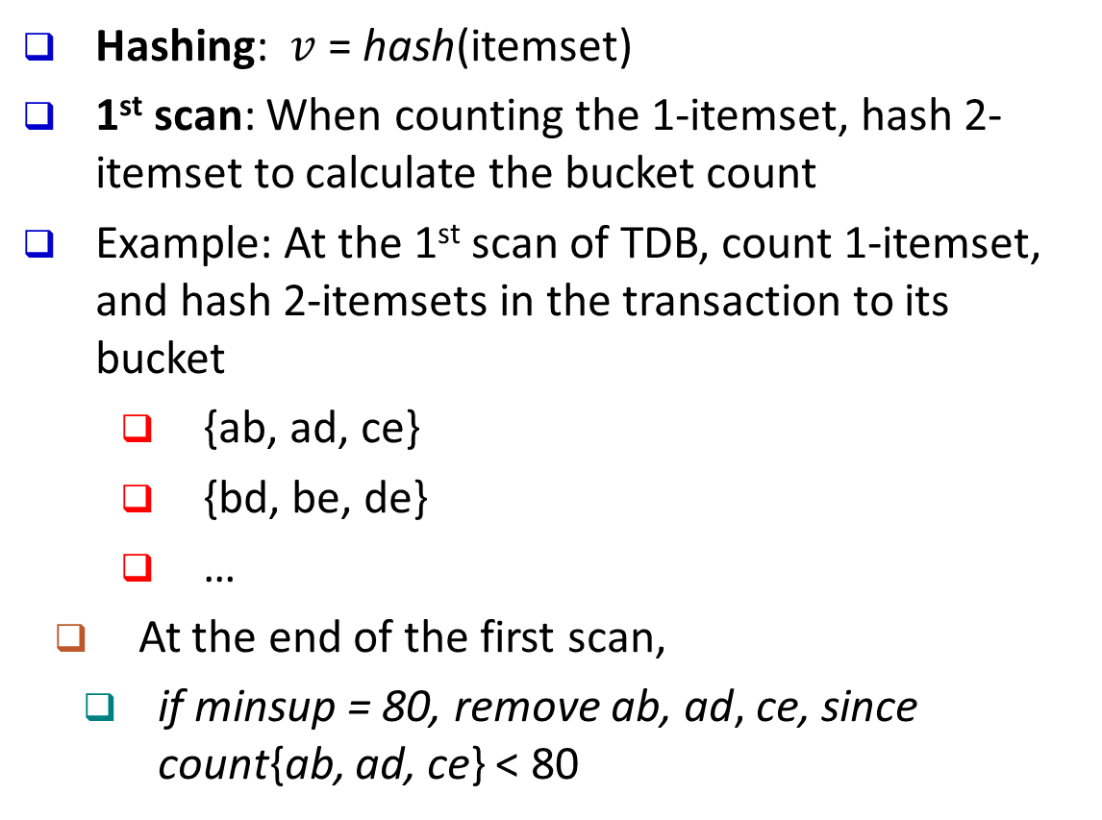
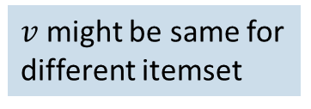
Direct Hashing and Pruning (DHP)
Hashing: $v$ = hash(itemset)
1st scan: When counting the 1-itemset, hash 2-itemset to calculate the bucket count
Example: At the 1st scan of TDB, count 1-itemset, and hash 2-itemsets in the transaction to its bucket
{ab, ad, ce}
{bd, be, de}
…
At the end of the first scan,
if minsup = 80, remove ab, ad, ce, since count{ab, ad, ce} < 80
Itemsets | Count
{ab, ad, ce} | 35
{bd, be, de} | 298
…… | …
{yz, qs, wt} | 58
$v$ might be same for different itemset
Hash Table
Check the minsup
A key observation: A k-itemset cannot be frequent if its corresponding hashing bucket count is below the minsup threshold
DHP (Direct Hashing and Pruning): (J. Park, M. Chen, and P. Yu, SIGMOD’95)

Slide 26
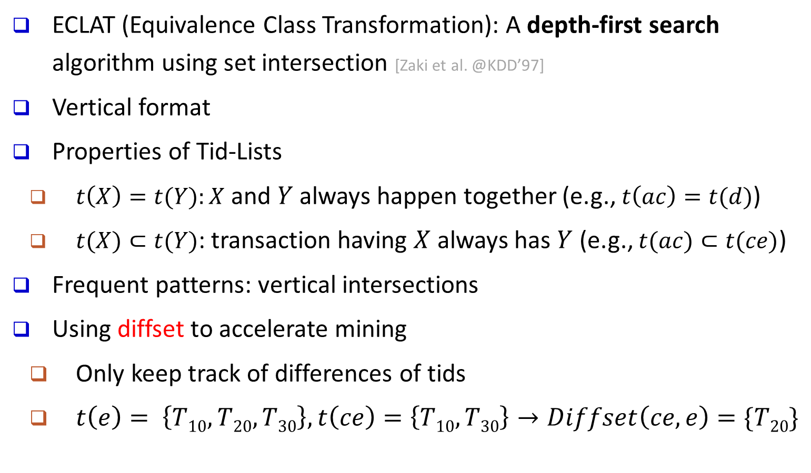
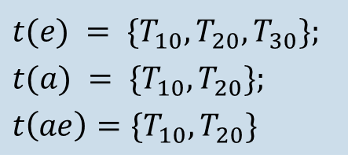
Exploring Vertical Data Format: ECLAT
ECLAT (Equivalence Class Transformation): A depth-first search algorithm using set intersection [Zaki et al. @KDD’97]
Vertical format
Properties of Tid-Lists
$t\left(X\right)=t(Y):X$ and $Y$ always happen together (e.g., $t\left(ac\right)=t(d)$)
$t(X)⊂t(Y)$: transaction having $X$ always has $Y$ (e.g., $t(ac)⊂t(ce)$)
Frequent patterns: vertical intersections
Using diffset to accelerate mining
Only keep track of differences of tids
$t\left(e\right)= \left\{T10, T20, T30\right\}, t\left(ce\right)=\left\{T10, T30\right\}→Diffset\left(ce, e\right)=\{T20\}$
A transaction DB in Horizontal Data Format
Tid | Itemset
10 | a, c, d, e
20 | a, b, e
30 | b, c, e
The transaction DB in Vertical Data Format
Item | TidList
a | 10, 20
b | 20, 30
c | 10, 30
d | 10
e | 10, 20, 30
$$t(e) = \{T_{10},T_{20},T_{30}\};$$
$$t(a) = \{T_{10},T_{20}\};$$
$$t\left(ae\right)=\{T_{10},T_{20}\}$$

Slide 27
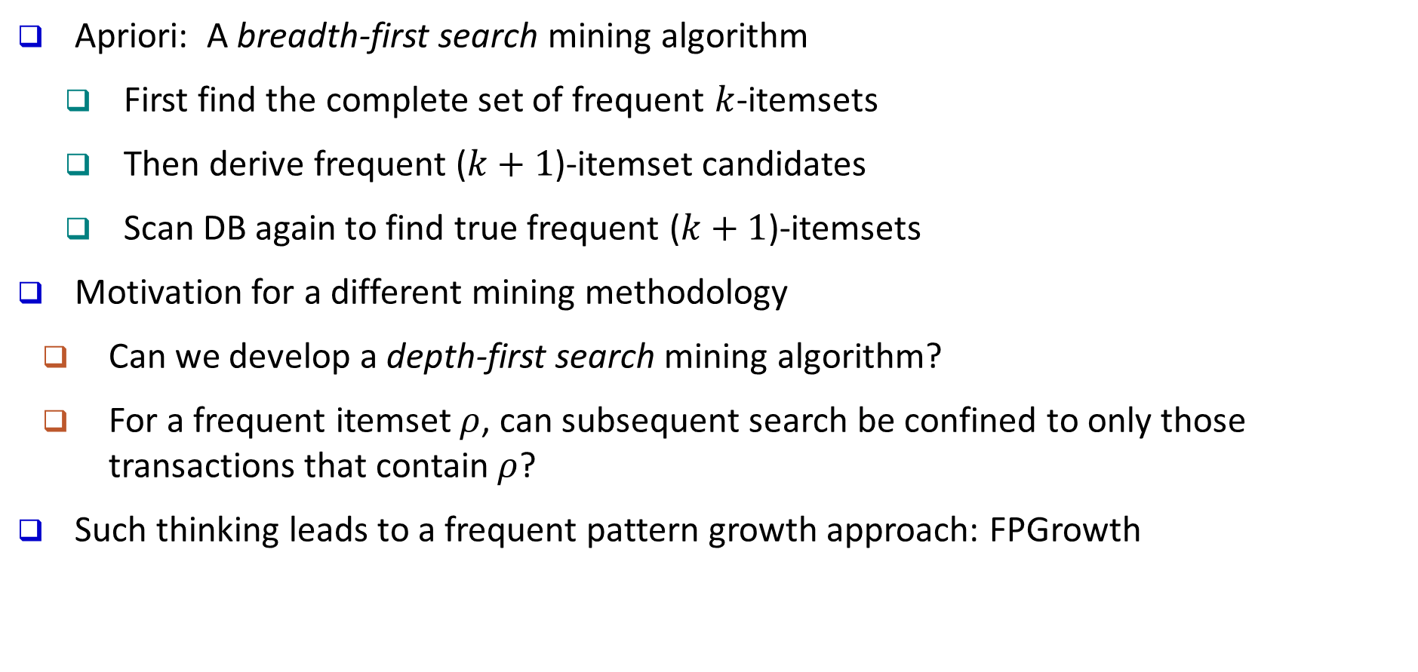
Why Mining Frequent Patterns by Pattern Growth?
Apriori: A breadth-first search mining algorithm
First find the complete set of frequent $k$-itemsets
Then derive frequent ($k+1$)-itemset candidates
Scan DB again to find true frequent ($k+1$)-itemsets
Motivation for a different mining methodology
Can we develop a depth-first search mining algorithm?
For a frequent itemset $ρ$, can subsequent search be confined to only those transactions that contain $ρ$?
Such thinking leads to a frequent pattern growth approach: FPGrowth
FPGrowth (J. Han, J. Pei, Y. Yin, “Mining Frequent Patterns without Candidate Generation,” SIGMOD 2000)

Slide 28
Example: From Transactional DB to Ordered Frequent Itemlist
Example: A Sample Transactional Database
TID | Items in the Transaction
100 | {f, a, c, d, g, i, m, p}
200 | {a, b, c, f, l, m, o}
300 | {b, f, h, j, o, w}
400 | {b, c, k, s, p}
500 | {a, f, c, e, l, p, m, n}
Let min_support = 3
f:4, a:3, c:4, b:3, m:3, p:3
Scan DB once, find single item frequent pattern:
Sort frequent items in frequency descending order, f-list
Scan DB again, use the ordered frequent itemlist for each transaction to construct an FP-tree
F-list = f-c-a-b-m-p
TID | Items in the Transaction | Ordered, frequent itemlist
100 | {f, a, c, d, g, i, m, p} | f, c, a, m, p
200 | {a, b, c, f, l, m, o} | f, c, a, b, m
300 | {b, f, h, j, o, w} | f, b
400 | {b, c, k, s, p} | c, b, p
500 | {a, f, c, e, l, p, m, n} | f, c, a, m, p

Slide 29
Example: Construct FP-tree from Transaction DB
After inserting the 1st frequent Itemlist:
“f, c, a, m, p”
After inserting the 2nd frequent itemlist
“f, c, a, b, m”
TID | Ordered, frequent itemlist
100 | f, c, a, m, p
200 | f, c, a, b, m
300 | f, b
400 | c, b, p
500 | f, c, a, m, p
{}
After inserting all the frequent itemlists
{}
{}
f:1
f:2
f:4
c:1
Item | Frqncy | hdr
f | 4
c | 4
a | 3
b | 3
m | 3
p | 3
Itm | hdr
f
c
a
b
m
p
Itm | hdr
f
c
a
b
m
p
c:1
c:2
c:3
b:1
b:1
FP-Tree Construction:
For each transaction, insert the ordered frequent itemlist into an FP-tree, with shared sub-branches merged, counts accumulated
a:1
a:2
a:3
p:1
m:1
m:1
b:1
m:2
b:1
p:1
p:1
m:1
p:2
m:1
Header Table

Slide 30
Mining FP-Tree: Divide and Conquer Based on Patterns and Data
Pattern mining can be partitioned according to current patterns
Patterns containing p: p’s conditional database: fcam:2, cb:1
p’s conditional database (i.e., the database under the condition that p exists):
transformed prefix paths of item p
Patterns having m but no p: m’s conditional database: fca:2, fcab:1
…… ……
{}
min_support = 3
Conditional database of each pattern
Item | Frequency | Header
f | 4
c | 4
a | 3
b | 3
m | 3
p | 3
f:4
c:1
Item Conditional database
c f:3
a fc:3
b fca:1, f:1, c:1
m fca:2, fcab:1
p fcam:2, cb:1
c:3
b:1
b:1
a:3
p:1
m:2
b:1
p:2
m:1

Slide 31
Mine Each Conditional Database Recursively
min_support = 3
For each conditional database
Mine single-item patterns
Construct its FP-tree & mine it
Conditional Data Bases
item cond. data base
c f:3
a fc:3
b fca:1, f:1, c:1
m fca:2, fcab:1
p fcam:2, cb:1
p’s conditional DB: fcam:2, cb:1 → c: 3
m’s conditional DB: fca:2, fcab:1 → fca: 3
b’s conditional DB: fca:1, f:1, c:1 → ɸ
{}
{}
{}
{}
Actually, for single branch FP-tree, all the frequent patterns can be generated in one shot
f:3
f:3
f:3
f:3
m: 3
fm: 3, cm: 3, am: 3
fcm: 3, fam:3, cam: 3
fcam: 3
c:3
c:3
cm’s FP-tree
cam’s FP-tree
a:3
am’s FP-tree
m’s FP-tree
Then, mining m’s FP-tree: fca:3

Slide 32
A Special Case: Single Prefix Path in FP-tree
Suppose a (conditional) FP-tree T has a shared single prefix-path P
Mining can be decomposed into two parts
Reduction of the single prefix path into one node
Concatenation of the mining results of the two parts
{}
a₁:n₁
a₂:n₂
r₁
{}
a₃:n₃

a₁:n₁
+
r₁
=
b₁:m₁
c₁:k₁
c₁:k₁
a₂:n₂
b₁:m₁
a₃:n₃
c₂:k₂
c₃:k₃
c₂:k₂
c₃:k₃

Slide 33
FPGrowth: Mining Frequent Patterns by Pattern Growth
Essence of frequent pattern growth (FPGrowth) methodology
Find frequent single items and partition the database based on each such single item pattern
Recursively grow frequent patterns by doing the above for each partitioned database (also called the pattern’s conditional database)
To facilitate efficient processing, an efficient data structure, FP-tree, can be constructed
Mining becomes
Recursively construct and mine (conditional) FP-trees
Until the resulting FP-tree is empty, or until it contains only one path—single path will generate all the combinations of its sub-paths, each of which is a frequent pattern

Slide 34
Scaling FP-growth by Item-Based Data Projection
What if FP-tree cannot fit in memory?—Do not construct FP-tree
“Project” the database based on frequent single items
Construct & mine FP-tree for each projected DB
Parallel projection vs. partition projection
Parallel projection: Project the DB on each frequent item
Space costly, all partitions can be processed in parallel
Partition projection: Partition the DB in order
Passing the unprocessed parts to subsequent partitions
Trans. DB
Parallel projection
Partition projection
f₂ f₃ f₄ g h
f₃ f₄ i j
f₂ f₄ k
f₁ f₃ h
…
f₄-proj. DB
f₃-proj. DB
f₄-proj. DB
f₃-proj. DB
Assume only f’s are frequent & the frequent item ordering is: f₁-f₂-f₃-f₄
f₂ f₃
f₃
f₂
…
f₂
f₁
…
f₂ f₃
f₃
f₂
…
f₁
…
f₂ will be projected to f₃-proj. DB only when processing f₄-proj. DB

Slide 35
Parallel Projection
Tran. DB
fcamp
fcabm
fb
cbp
fcamp
p-proj DB
fcam
cb
fcam
m-proj DB
fca
fcab
fca
b-proj DB
fca
f
c
a-proj DB
fc
fc
fc
c-proj DB
f
f
f
f-proj DB
<empty>

Slide 36
Partition-Based Projection
Parallel projection needs a lot of disk space
Partition projection saves it
Tran. DB
fcamp
fcabm
fb
cbp
fcamp
p-proj DB
fcam
cb
fcam
m-proj DB
fcab
fca
fca
b-proj DB
f
c
…
a-proj DB
fc
…
c-proj DB
f
…
f-proj DB
…
am-proj DB
fc
fc
fc
cm-proj DB
f
f
f
…

Slide 37
Mining Frequent Closed Patterns: CLOSET
Flist: list of all frequent items in support descending order
Flist: c-e-f-a-d
Divide search space
Patterns having d
Patterns having a but no d, etc.
Find frequent closed pattern recursively
Every transaction having d also has cfa → cfad is a frequent closed pattern
J. Pei, J. Han & R. Mao. “CLOSET: An Efficient Algorithm for Mining Frequent Closed Itemsets", DMKD'00.
Min_sup=2
TID | Items
10 | a, c, d, e, f
20 | a, b, e
30 | c, e, f
40 | a, c, d, f
50 | c, e, f

Slide 38
How CLOSET Works? An Example
Transaction ID | Items
10 | a, c, d, e, f
20 | a, b, e
30 | c, e, f
40 | a, c, d, f
50 | c, e, f
Step 1. Find frequent items
min_sup =2
List of frequent items in support descending order
f_list=<c:4, e:4, f:4, a:3, d:2>

Slide 39
Divide Search Space
All frequent closed itemsets can be divided into 5 non-overlap subsets based on f_list
The ones containing d
The ones containing a but no d
The ones containing f but no a nor d
The ones containing e but no f, a nor d
The ones containing only c
Transaction ID | Items
10 | a, c, d, e, f
20 | a, b, e
30 | c, e, f
40 | a, c, d, f
50 | c, e, f
f_list=<c:4, e:4, f:4, a:3, d:2>

Slide 40
Find Frequent Closed Itemsets Containing d
TDB
cefad
ea
cef
cfad
cef
f_list:<c:4, e:4, f:4, a:3, d:2>
Local frequent items: c, f, a
TDB|_{d} (d:2)
cefa
cfa
TDB|_{a} (a:3)
cef
e
cf
TDB|_{f} (f:4)
ce:3
c
TDB|_{e} (e:4)
c:3
F.C.I.: e:4
F.C.I.: cfad:2
F.C.I.: cf:4, cef:3
Every transaction having d also contains c, f and a
F.C.I.: a:3
TDB|_{ea} (ea:2)
c
F.C.I.: ea:2

Slide 41
Find Frequent Closed Itemsets Containing a but No d
TDB
cefad
ea
cef
cfad
cef
Frequent closed itemsets containing a but no d can be further partitioned into subsets
Ones having af but no d
Ones having ae but no d nor f
Ones having ac but no d, e nor f
f_list:<c:4, e:4, f:4, a:3, d:2>
TDB|_{d} (d:2)
cefa
cfa
TDB|_{a} (a:3)
cef
e
cf
TDB|_{f} (f:4)
ce:3
c
TDB|_{e} (e:4)
c:3
F.C.I.: e:4
F.C.I.: cfad:2
F.C.I.: cf:4, cef:3
sup(fa)=sup(ca)=sup(cfad)
No FCI having fa or ca but no d
F.C.I.: a:3
TDB|_{ea} (ea:2)
c
F.C.I.: ea:2

Slide 42
Find Frequent Closed Itemsets Containing f but No a Nor d
TDB
cefad
ea
cef
cfad
cef
f_list:<c:4, e:4, f:4, a:3, d:2>
TDB|_{d} (d:2)
cefa
cfa
TDB|_{a} (a:3)
cef
e
cf
TDB|_{f} (f:4)
ce:3
c
TDB|_{e} (e:4)
c:3
F.C.I.: e:4
F.C.I.: cfad:2
F.C.I.: cf:4, cef:3
F.C.I.: a:3
TDB|_{ea} (ea:2)
c
F.C.I.: ea:2

Slide 43
Find Frequent Closed Itemsets Containing e but No f, a Nor d
TDB
cefad
ea
cef
cfad
cef
f_list:<c:4, e:4, f:4, a:3, d:2>
TDB|_{d} (d:2)
cefa
cfa
TDB|_{a} (a:3)
cef
e
cf
TDB|_{f} (f:4)
ce:3
c
TDB|_{e} (e:4)
c:3
F.C.I.: e:4
F.C.I.: cfad:2
F.C.I.: cf:4, cef:3
F.C.I.: a:3
TDB|_{ea} (ea:2)
c
F.C.I.: ea:2

Slide 44
Find Frequent Closed Itemsets Containing Only c
sup(c)=sup(cf), c is not a closed itemset
In summary, the set of frequent closed itemsets is
{acdf:2, a:3, ae:2, cf:4, cef:3, e:4}

Slide 45
Pattern Mining: Basic Concepts and Methods
Basic Concepts
Frequent Itemset Mining Methods
Which Patterns Are Interesting?—Pattern Evaluation Methods
Summary

Slide 46
How to Judge if a Rule/Pattern Is Interesting?
Pattern-mining will generate a large set of patterns/rules
Not all the generated patterns/rules are interesting
Interestingness measures: Objective vs. subjective
Objective interestingness measures
Support, confidence, correlation, …
Subjective interestingness measures:
Different users may judge interestingness differently
Let a user specify
Query-based: Relevant to a user’s particular request
Judge against one’s knowledge-base
unexpected, freshness, timeliness

Slide 47
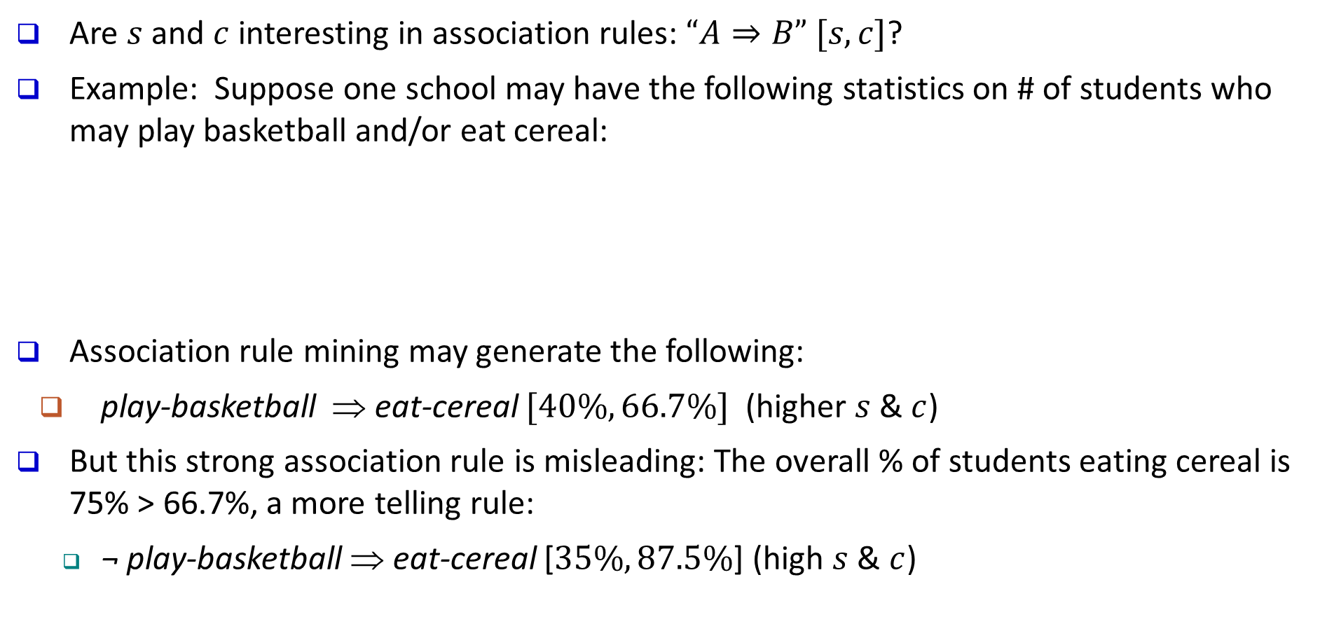
Limitation of the Support-Confidence Framework
Are $s$ and $c$ interesting in association rules: $“A⇒B” [s, c]$?
Example: Suppose one school may have the following statistics on # of students who may play basketball and/or eat cereal:
Association rule mining may generate the following:
play-basketball ⇒ eat-cereal $[40\%, 66.7\%]$ (higher $s$ & $c$)
But this strong association rule is misleading: The overall % of students eating cereal is 75% > 66.7%, a more telling rule:
¬ play-basketball ⇒ eat-cereal [$35\%, 87.5\%$] (high $s$ & $c$)
Be careful!
 | play-basketball | not play-basketball | sum (row)
eat-cereal | 400 | 350 | 750
not eat-cereal | 200 | 50 | 250
sum(col.) | 600 | 400 | 1000
2-way contingency table

Slide 48
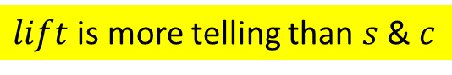
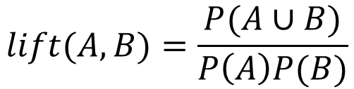
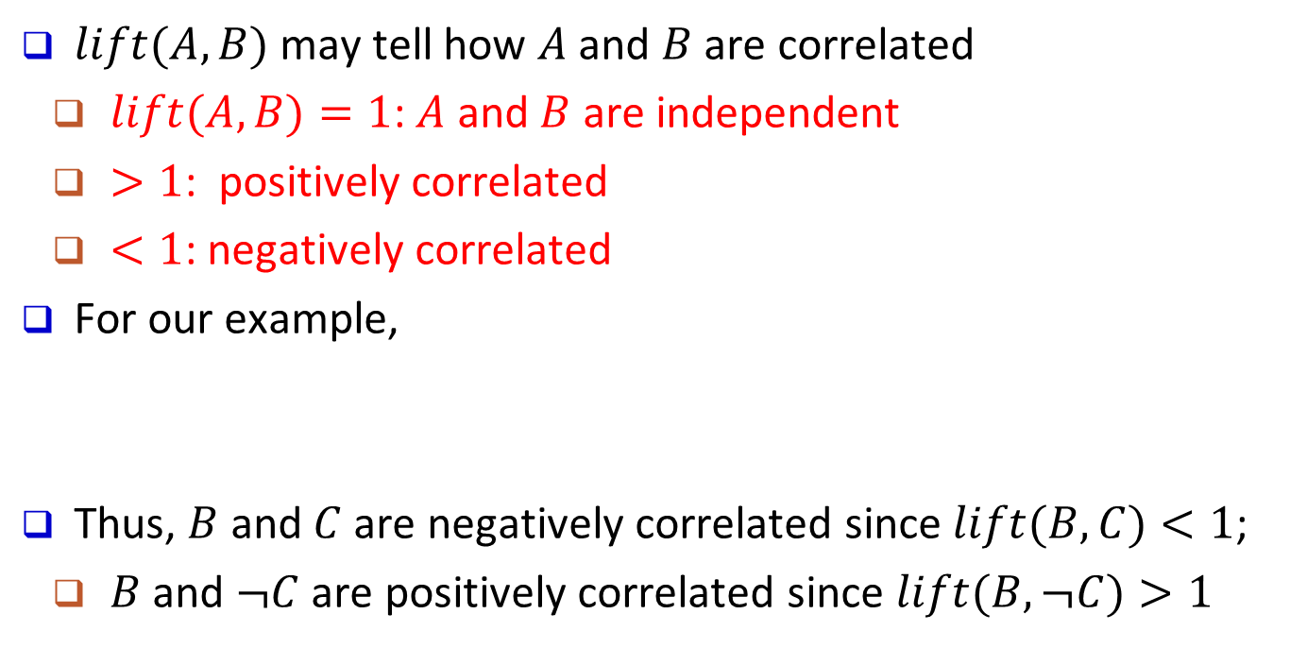
Interestingness Measure: Lift
Measure of dependent/correlated events: $lift$
$lift$ is more telling than $s$ & $c$
$$lift(A,B)=\frac{P(A∪B)}{P\left(A\right)P(B)}$$
 | B | ¬B | ∑_{row}
C | 400 | 350 | 750
¬C | 200 | 50 | 250
∑_{col.} | 600 | 400 | 1000
$lift(A,B)$may tell how $A$ and $B$ are correlated
$lift(A,B)=1$: $A$ and $B$ are independent
$>1$: positively correlated
$<1$: negatively correlated
For our example,
Thus, $B$ and $C$ are negatively correlated since $lift(B, C)<1$;
$B$ and $¬C$ are positively correlated since $lift(B, ¬C)>1$

Slide 49
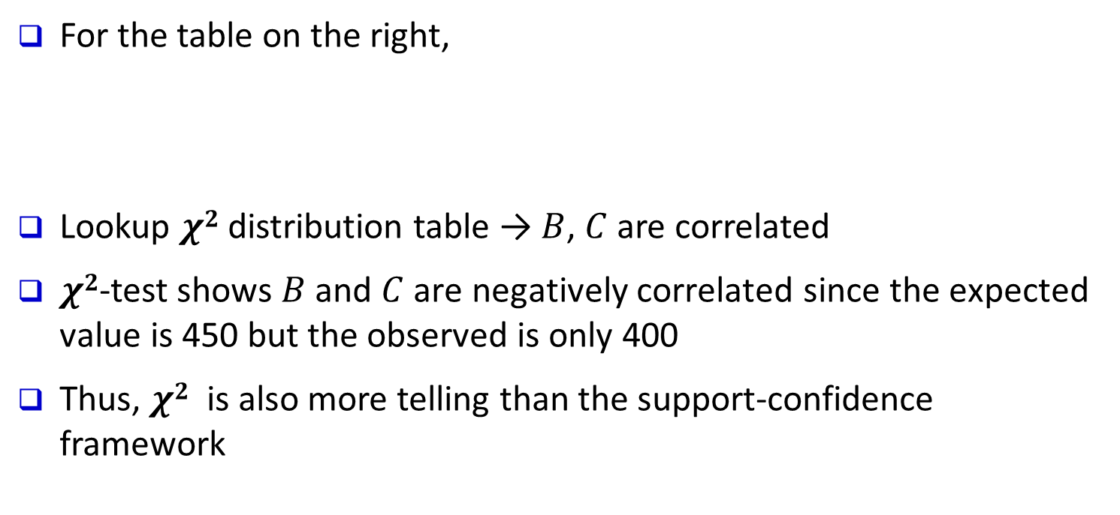
Interestingness Measure: χ²
Another measure to test correlated events: $χ2$
 | B | ¬B | ∑_{row}
C | 400 (450) | 350 (300) | 750
¬C | 200 (150) | 50 (100) | 250
∑_{col} | 600 | 400 | 1000
For the table on the right,
Lookup $χ2$ distribution table → $B$, $C$ are correlated
$χ2$-test shows $B$ and $C$ are negatively correlated since the expected value is 450 but the observed is only 400
Thus, $χ2$ is also more telling than the support-confidence framework
Expected value
Observed value

Slide 50
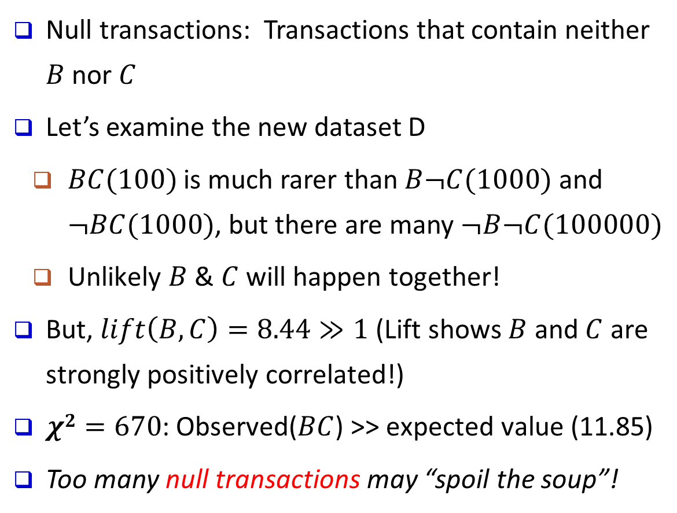
Lift and χ² : Are They Always Good Measures?
Null transactions: Transactions that contain neither $B$ nor $C$
Let’s examine the new dataset D
$BC(100)$is much rarer than $B¬C(1000)$ and $¬BC(1000)$, but there are many $¬B¬C(100000)$
Unlikely $B$ & $C$ will happen together!
But, $lift\left(B, C\right)=8.44≫1$ (Lift shows $B$ and $C$ are strongly positively correlated!)
$χ2=670$: Observed($BC$) >> expected value (11.85)
Too many null transactions may “spoil the soup”!
 | B | ¬B | ∑_{row}
C | 100 | 1000 | 1100
¬C | 1000 | 100000 | 101000
∑_{col.} | 1100 | 101000 | 102100
null transactions
Contingency table with expected values added
 | B | ¬B | ∑_{row}
C | 100 (11.85) | 1000 | 1100
¬C | 1000 (988.15) | 100000 | 101000
∑_{col.} | 1100 | 101000 | 102100

Slide 51
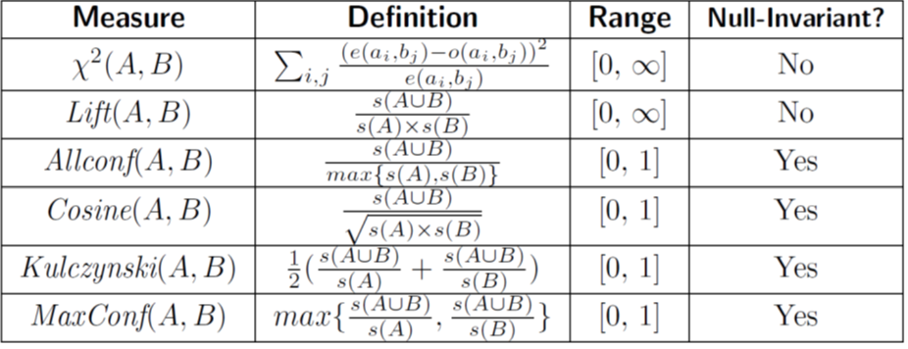
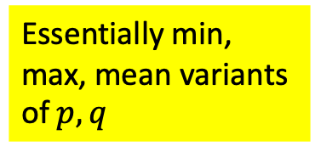
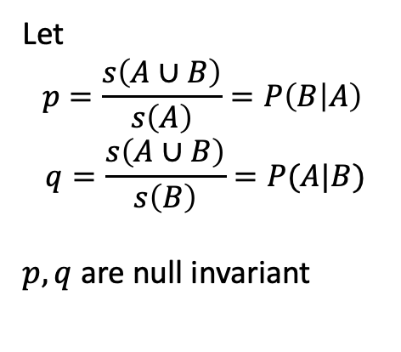
Interestingness Measures & Null-Invariance
Null invariance means: The number of null transactions does not matter. Does not change the measure value.
A few interestingness measures: Some are null invariant
Let
$$p=\frac{s\left(A∪B\right)}{s\left(A\right)}=P\left(B | A\right)$$
$$q=\frac{s\left(A∪B\right)}{s\left(B\right)}=P(A|B)$$
$p, q$ are null invariant
Essentially min, max, mean variants of $p, q$

Slide 52
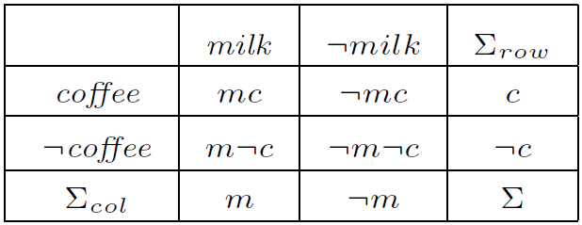
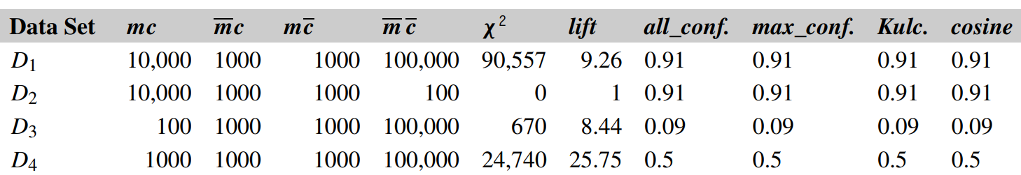
Null Invariance: An Important Property
Why is null invariance crucial for the analysis of massive transaction data?
Many transactions may contain neither milk nor coffee!
Lift and χ² are not null-invariant: not good to evaluate data that contain too many or too few null transactions!
Many measures are not null-invariant!
milk vs. coffee contingency table
Null-transactions
w.r.t. m and c

Slide 53
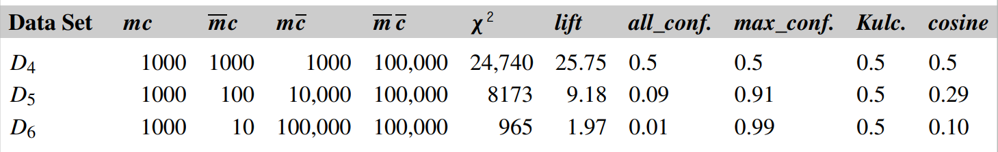
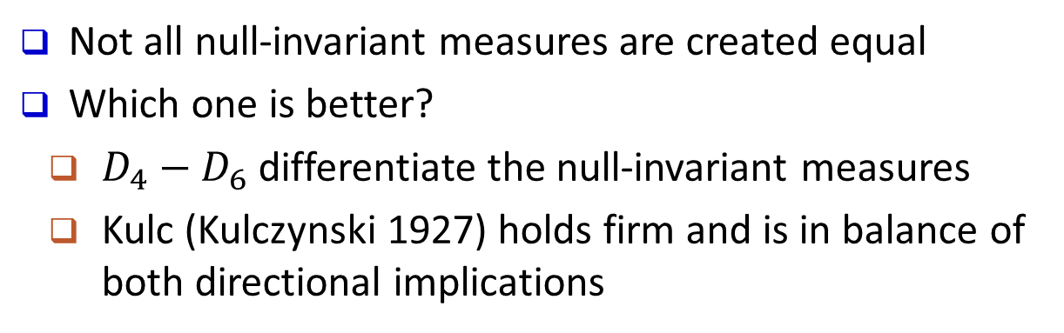
Comparison of Null-Invariant Measures
Not all null-invariant measures are created equal
Which one is better?
$D_{4}−D_{6}$differentiate the null-invariant measures
Kulc (Kulczynski 1927) holds firm and is in balance of both directional implications
2-variable contingency table
Subtle: They disagree on those cases

Slide 54
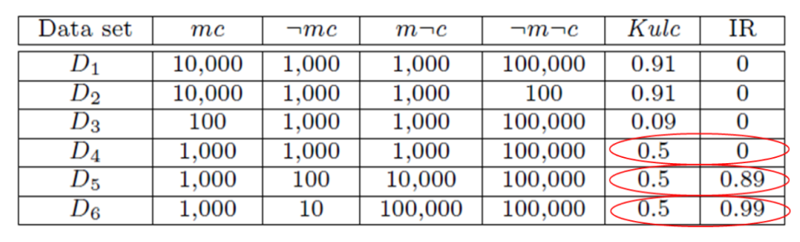
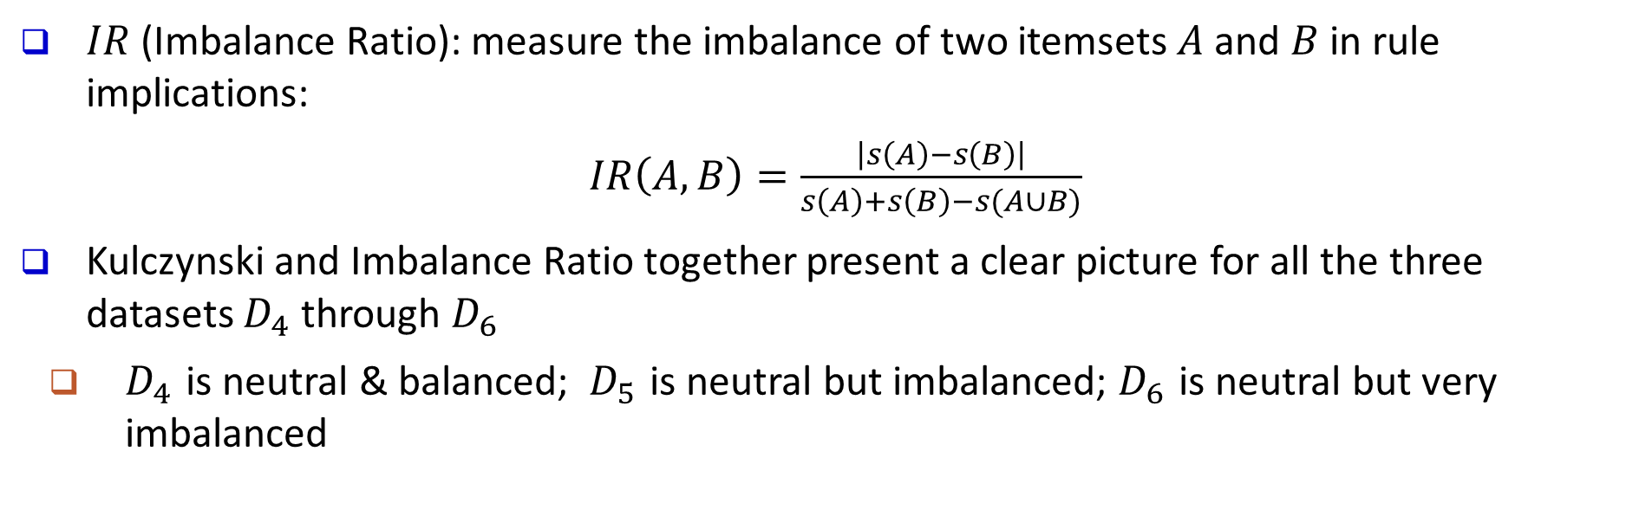
Imbalance Ratio with Kulczynski Measure
$IR$ (Imbalance Ratio): measure the imbalance of two itemsets $A$ and $B$ in rule implications:
$IR\left(A, B\right)=\frac{\left|s\left(A\right)−s\left(B\right)\right|}{s\left(A\right)+s\left(B\right)−s(A∪B)}$
Kulczynski and Imbalance Ratio together present a clear picture for all the three datasets $D_{4}$ through $D_{6}$
$D_{4}$ is neutral & balanced; $D_{5}$ is neutral but imbalanced; $D_{6}$ is neutral but very imbalanced

Slide 55
What Measures to Choose for Effective Pattern Evaluation?
Null value cases are predominant in many large datasets
Neither milk nor coffee is in most of the baskets; neither Mike nor Jim is an author in most of the papers; ……
Null-invariance is an important property
Lift, χ² and cosine are good measures if null transactions are not predominant
Otherwise, Kulczynski + Imbalance Ratio should be used to judge the interestingness of a pattern

Slide 56
Pattern Mining: Basic Concepts and Methods
Basic Concepts
Frequent Itemset Mining Methods
Which Patterns Are Interesting?—Pattern Evaluation Methods
Summary

Slide 57
Summary
Basic Concepts
What Is Pattern Discovery? Why Is It Important?
Basic Concepts: Frequent Patterns and Association Rules
Compressed Representation: Closed Patterns and Max-Patterns
Efficient Pattern Mining Methods
The Downward Closure Property of Frequent Patterns
The Apriori Algorithm
Extensions or Improvements of Apriori
Mining Frequent Patterns by Exploring Vertical Data Format
FPGrowth: A Frequent Pattern-Growth Approach
Mining Closed Patterns
Pattern Evaluation
Interestingness Measures in Pattern Mining
Interestingness Measures: Lift and χ²
Null-Invariant Measures
Comparison of Interestingness Measures

Slide 58
Recommended Readings (Basic Concepts)
R. Agrawal, T. Imielinski, and A. Swami, “Mining association rules between sets of items in large databases”, in Proc. of SIGMOD'93
R. J. Bayardo, “Efficiently mining long patterns from databases”, in Proc. of SIGMOD'98
N. Pasquier, Y. Bastide, R. Taouil, and L. Lakhal, “Discovering frequent closed itemsets for association rules”, in Proc. of ICDT'99
J. Han, H. Cheng, D. Xin, and X. Yan, “Frequent Pattern Mining: Current Status and Future Directions”, Data Mining and Knowledge Discovery, 15(1): 55-86, 2007

Slide 59
Recommended Readings (Efficient Pattern Mining Methods)
R. Agrawal and R. Srikant, “Fast algorithms for mining association rules”, VLDB'94
A. Savasere, E. Omiecinski, and S. Navathe, “An efficient algorithm for mining association rules in large databases”, VLDB'95
J. S. Park, M. S. Chen, and P. S. Yu, “An effective hash-based algorithm for mining association rules”, SIGMOD'95
S. Sarawagi, S. Thomas, and R. Agrawal, “Integrating association rule mining with relational database systems: Alternatives and implications”, SIGMOD'98
M. J. Zaki, S. Parthasarathy, M. Ogihara, and W. Li, “Parallel algorithm for discovery of association rules”, Data Mining and Knowledge Discovery, 1997
J. Han, J. Pei, and Y. Yin, “Mining frequent patterns without candidate generation”, SIGMOD’00
M. J. Zaki and Hsiao, “CHARM: An Efficient Algorithm for Closed Itemset Mining”, SDM'02
J. Wang, J. Han, and J. Pei, “CLOSET+: Searching for the Best Strategies for Mining Frequent Closed Itemsets”, KDD'03
C. C. Aggarwal, M.A., Bhuiyan, M. A. Hasan, “Frequent Pattern Mining Algorithms: A Survey”, in Aggarwal and Han (eds.): Frequent Pattern Mining, Springer, 2014

Slide 60
Recommended Readings (Pattern Evaluation)
C. C. Aggarwal and P. S. Yu. A New Framework for Itemset Generation. PODS’98
S. Brin, R. Motwani, and C. Silverstein. Beyond market basket: Generalizing association rules to correlations. SIGMOD'97
M. Klemettinen, H. Mannila, P. Ronkainen, H. Toivonen, and A. I. Verkamo. Finding interesting rules from large sets of discovered association rules. CIKM'94
E. Omiecinski. Alternative Interest Measures for Mining Associations. TKDE’03
P.-N. Tan, V. Kumar, and J. Srivastava. Selecting the Right Interestingness Measure for Association Patterns. KDD'02
T. Wu, Y. Chen and J. Han, Re-Examination of Interestingness Measures in Pattern Mining: A Unified Framework, Data Mining and Knowledge Discovery, 21(3):371-397, 2010

